Slide 1
Energy-efficient Cloud Computing
Name: Aditya Vikramsinh Desai
Roll: PC - 15
Guide: Prof. Rajendra G. Pawar

Slide 2
Introduction
Given the perpetual surging of cloud services’ requests, energy consumption of cloud data centers with their related CO2 emissions still represents major issues.
Rapid progress of mobile and networking technologies resulted in the implementation of an extensive data-centric tasks, resulting a critical need for energy efficient task scheduling schemes for data centers.
The main consumers of power in a datacenter are servers, communications network and the cooling system.
What is the problem?

Slide 3
Motivation
According to a recent Cisco report, annual global cloud IP traffic will reach 14.1 ZB (1.2 ZB per month) by the end of 2020 and total hyperscale data centers (DCs) number in this year will extend to 485.
The more we send email, watch online videos, conduct business online and use social media like Facebook, the more demands on data centers will grow.
Given the perpetual evolution of heterogeneous on-demand requests and the huge need of an elastic cloud, the so-called green or sustainable cloud computing has been getting a lot of interest in recent years.
Why to look into this problem?

Slide 4
Literature Review

Slide 5
Literature Review
Consolidating workload on an optimized number of resources and switching off idle ones are one of the most common solutions. Shutdown techniques can save at least 84% of energy that would be otherwise lost to power idle nodes.
Such solutions can be easily exploited thanks to virtualization and/or containerization technologies by deploying multiple instances of resources hosted over a physical server.
These various instances require energy-efficient scheduling that can be either: static or dynamic, vertical or horizontal and reactive or proactive.
However, cloud computing resources not only settle for DCs infrastructures, but also refer to a wide range of network resources, since cloud is mainly a distributed and clustering system that extends over a wide geographical area.

Slide 6
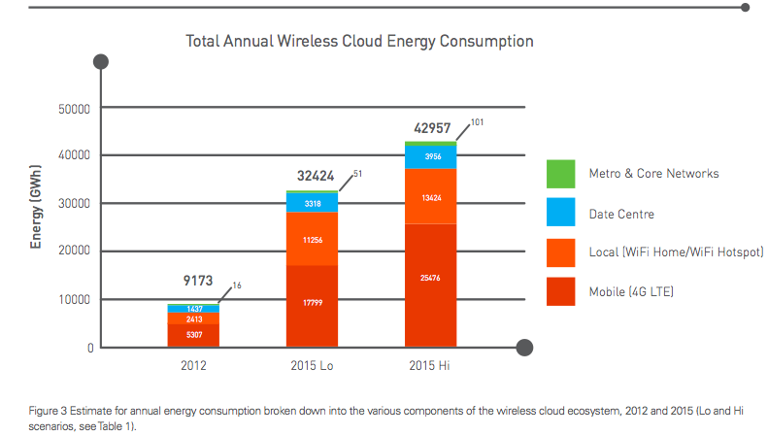
Energy Consumption

Slide 7
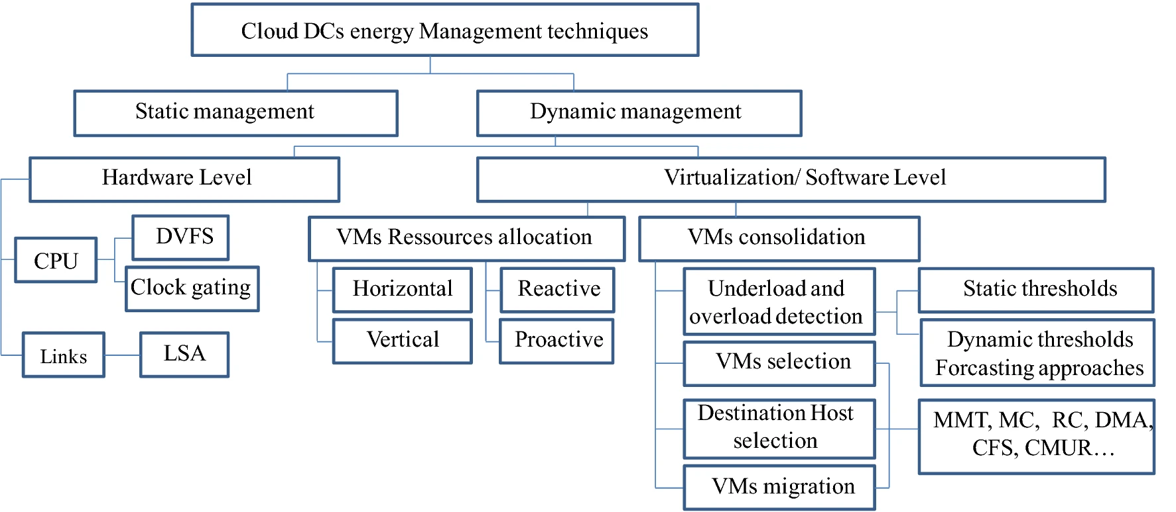
Energy Management Techniques

Slide 8
Virtual Resources Management
The provisioning of virtual machines (VMs) is fundamental for infrastructure services, IaaS. The virtualization technique allows a number of virtual machines to be allocated into one physical machine.
Bin-packing (BP) technique is widely used to fulfill a main objective, which is consolidating VMs on the minimum number of servers when allocating resources to VMs where objects with a given area must be packed into a finite number of bins with a given area such that the minimum amounts of bins are used.

Slide 9
Some Methods for VM Resource Allocation
VM manager collects and store the user requested incoming VMs in the virtual machine list at a regular time interval and waits for allocation in the list.
Assigning the tasks to appropriate V.M which is able to allocate CPU, memory, storage, S.L.A requirements of the task, able to withstand temperature rise due to execution of the task, and left with a maximum energy residue.

Slide 10
Container Resources Management
Container as a service is a new layer that becomes recently majorly deployed in cloud environment for its large benefit on energy efficiency.
Similar to VMs, containers are also characterized by their requests of several resources. However, containers startup time usually takes only a couple of seconds, since application in a container is partially dissociated from operating system.
The most known containers manager is Docker. This study indicates that VM containers are very close to native Docker containers deployment or, in certain cases, slightly better in terms of latency.

Slide 11
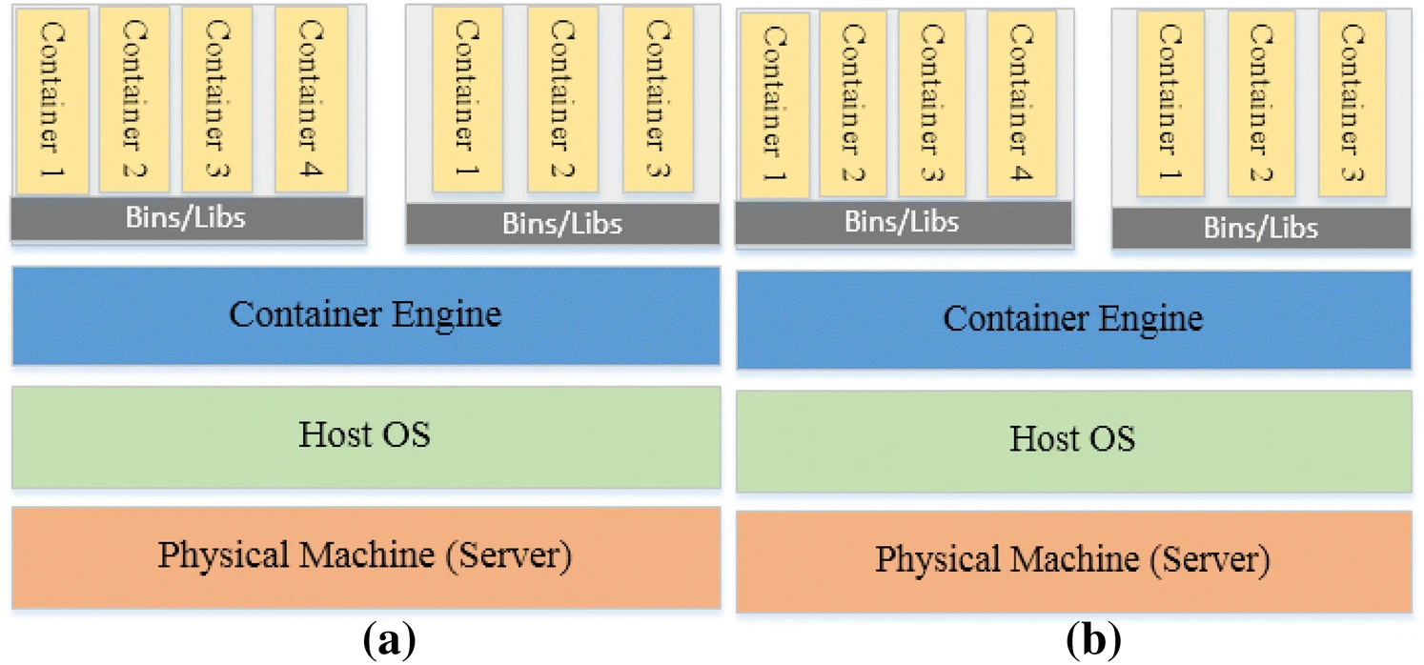
Container Resources Management

Slide 12
Some other methods:
Some other methods that I will be mentioning in the paper are:
Predictive Techniques
Location-Aware Virtual Network Embedding
Temporal load aware resource allocation

Slide 13
Research Gaps identified
From technical and metaheuristic point of view, for solving NP-hard reactive or proactive cloud resources provisioning problem, it is difficult to deduce what each technique performs best in.
None of them can solve all problems, since each of them works best in an environment of specific parameters and specifications.

Slide 14
Future Scope
Having regard to cloud challenges that are still actually under investigations, there are several noticed open challenges
A complete optimization of resources usage through an energy-efficient virtual resources allocation management is not only restricted to computing resources, but also is expected to extend beyond local and backbone network resources.

Slide 15
Conclusion
In this paper, we survey cloud resources provisioning algorithms and techniques with as the first objective the energy saving, meanwhile maintaining performance level.
Different approaches and policies aforementioned are adopted to address either one objective or a combination of different kinds of specifications.
The majority of these studies consider just computing resources, while just a small part of them deal with various combinations of cloud computing and networking resources. s

Slide 16
References
Hamzaoui, I., Duthil, B., Courboulay, V. et al. A Survey on the Current Challenges of Energy-Efficient Cloud Resources Management. SN COMPUT. SCI. 1, 73 (2020).
M. Sarvabhatla, S. Konda, C. S. Vorugunti and M. M. N. Babu, "A Dynamic and Energy Efficient Greedy Scheduling Algorithm for Cloud Data Centers," 2017 IEEE International Conference on Cloud Computing in Emerging Markets (CCEM), Bangalore, 2017, pp. 47-52.
Y. Zong et al., "Location-aware energy efficient virtual network embedding in software-defined optical data center networks," in IEEE/OSA Journal of Optical Communications and Networking, vol. 10, no. 7, pp. 58-70, July 2018.
Vakilinia, S. Energy efficient temporal load aware resource allocation in cloud computing datacenters. J Cloud Comp 7, 2 (2018).
K. M. Nwe, M. K. Oo and M. M. Htay, "Efficient Resource Management for Virtual Machine Allocation in Cloud Data Centers," 2018 IEEE 7th Global Conference on Consumer Electronics (GCCE), Nara, 2018, pp. 419-420.

